Slide 1
To analyse the motion on inclined planes
Success Criteria
For objects on an inclined plane:
I can draw a free body diagram
I can calculate net force and acceleration

Slide 2
To analyse the motion on inclined planes
Content Development
Free body diagram:
F_{N}
F_{N}
F_{g}
F_{g}
The normal force always act perpendicular to the surface. It is a contact force due to the compression of the surface by the object.
In inclined planes, its magnitude is equal to the component of the weight force that is perpendicular to the surface.
Notes:
Weight (Fg) acts perpendicular to the Earth. Normal force acts perpendicular to the surface.
Start by looking at the flat surface. The ball is stationary. There is no net force.
Now the inclined plane. What do you expect to happen here? Why?
The normal force is acting perpendicular to the surface. The forces are unbalanced so we expect motion.

Slide 3
To analyse the motion on inclined planes
Content Development
Vector diagram:
F_{N}
F_{net}
F_{g}
F_{g}
F_{N}
There is a net force down the slope and the ball, therefore, accelerates as predicted by Newton’s second law.
Notes:
There is net force acting down the surface. The ball will move down the surface.

Slide 4
To analyse the motion on inclined planes
Content Development
When analysing motion on an inclined plane, we normally use the plane itself as the frame of reference. That is: we want to know whether and how fast the object is accelerating down the slope.
The normal force is already perpendicular to the slope. The net force is already parallel to the slope.
So we just have to resolve F_{g} into its components. The component of F_{g} parallel to the slope will be the force responsible for the object’s motion.
F_{N}
F_{g}
F_{net}
F_{g}
F_{N}

Slide 5
To analyse the motion on inclined planes
Content Development
Resolving F_{g} to its components
F_{g}sinθ = F_{net}
The component of the weight directly down the slope is responsible for the motion.
F_{net}
F_{g}cosθ
θ
F_{g}
F_{N}
F_{g}sinθ
θ
Notes:
Question: how to find theta?

Slide 6
To analyse the motion on inclined planes
Content Development
Resolving F_{g} to its components
F_{net} = F_{g}sinθ
F_{g} = mg
F_{net} = mg sinθ
F_{net}
F_{g}cosθ
θ
F_{g}
F_{N}
F_{g}sinθ
θ
Notes:
Question: how to find theta?

Slide 7
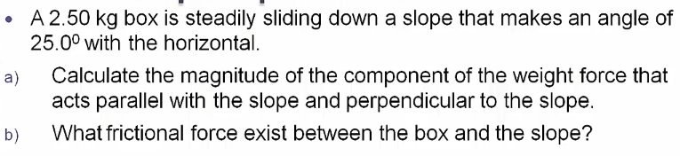
To analyse the motion on inclined planes
Worked Example
Notes:
s, u and a must be in the same direction

Slide 8
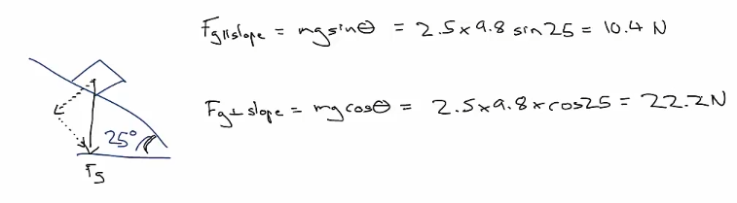
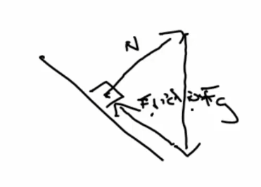
To analyse the motion on inclined planes
Worked Example
No acceleration therefore net force = 0
Friction must be equal to the force down the slope = 10.4 N
Notes:
Majority of the force is acting into the slope (not down the slope).
What happens as the angle of the slope increases? Calc for 45 deg.

Slide 9
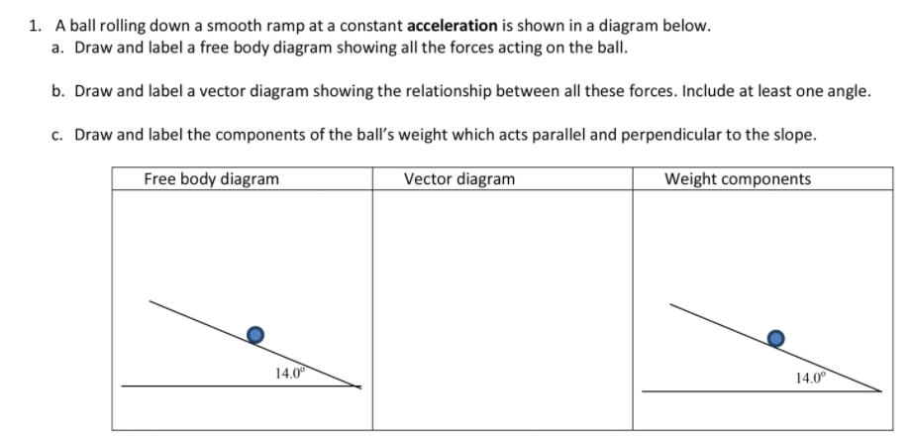
To analyse the motion on inclined planes
You Do

Slide 10
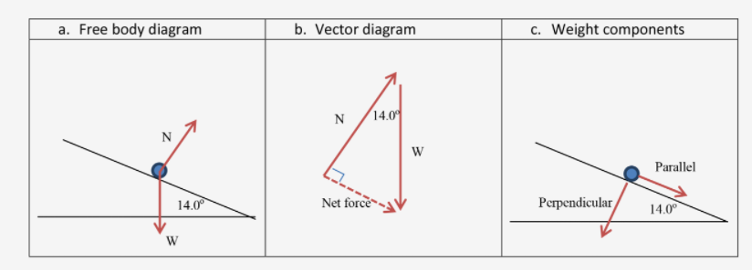
To analyse the motion on inclined planes
Content Development

Slide 11
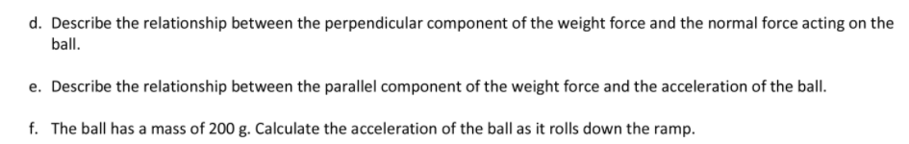
To analyse the motion on inclined planes
You Do

Slide 12
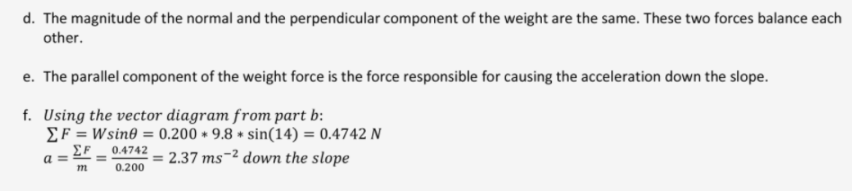
To analyse the motion on inclined planes
Content Development

Slide 13
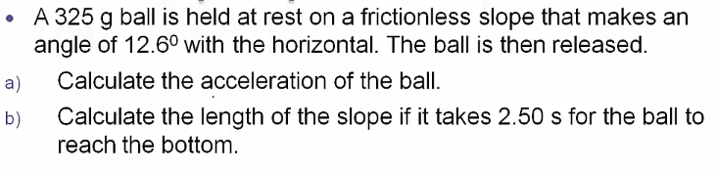
To analyse the motion on inclined planes
Worked Example
Remember: s = ut + ½ at²

Slide 14
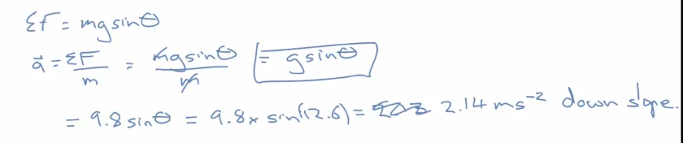
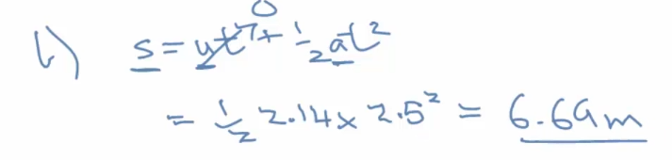
To analyse the motion on inclined planes
Worked Example

Slide 15
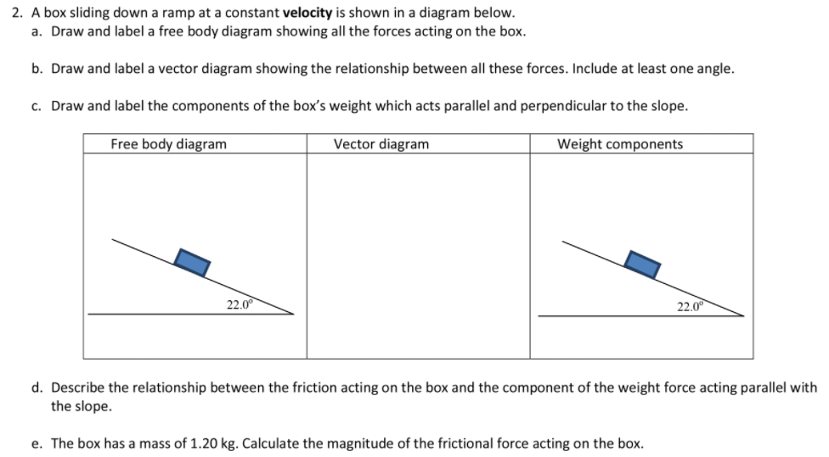
To analyse the motion on inclined planes
You Do

Slide 16
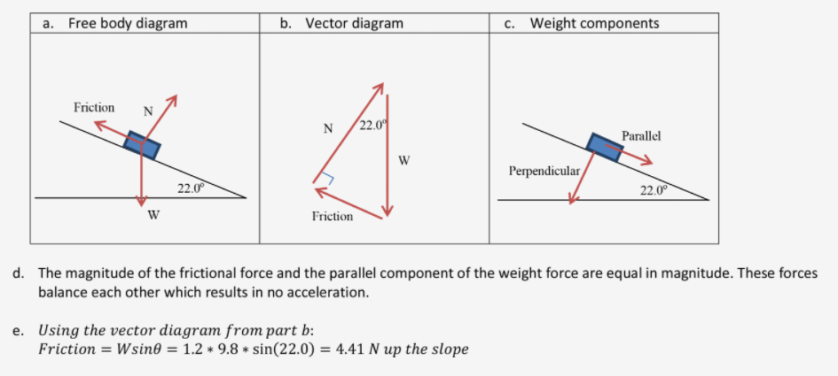
To analyse the motion on inclined planes
You Do

Slide 17
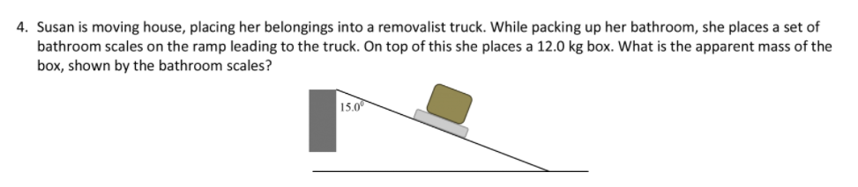
To analyse the motion on inclined planes
Questions / Homework
Watch the angle
Due Monday 7 Feb
Optional: All of Pearson’s 2.1 Review as well
Notes:
Reference: Step Up in Education

Slide 18
To analyse the motion on inclined planes
Exam Advice
Remember and be comfortable drawing the vector diagram for an object on a slope.
Remember that the angle of the slope is the same as the angle at the top of the vector triangle
Exam questions may add extra forces (such as friction) to confuse you. Remember that the component of the weight force acting parallel to the slope is responsible for the motion but it is not necessarily the net force.
  Draw a free body diagram every time!
  Consider all the forces acting on the object (including friction and applied)

Slide 19
To analyse the motion on inclined planes
Success Criteria
For objects on an inclined plane:
I can draw a free body diagram
I can calculate net force and acceleration

